Slide 1
Sustainable Development

Slide 2
Human Needs
Energy
Water
Food
Clothing
Shelter
Transportation
Health
Waste Assimilation
Security

Slide 3
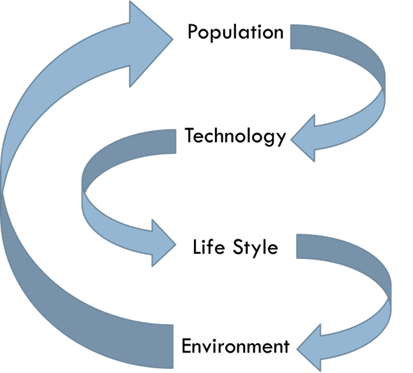
SUSTAINABILITY PILLARS

Slide 4
Common Terms
Climate Change
Global Warming
Green Engineering
Sea Level Rise
Carbon Footprint
Greenhouse Gases
CFCs
People Problem
Greed & Ethics Violations
Land & Resources
Food, Water and Shelter
Power-Regimes, Autocrats

